Slide 1

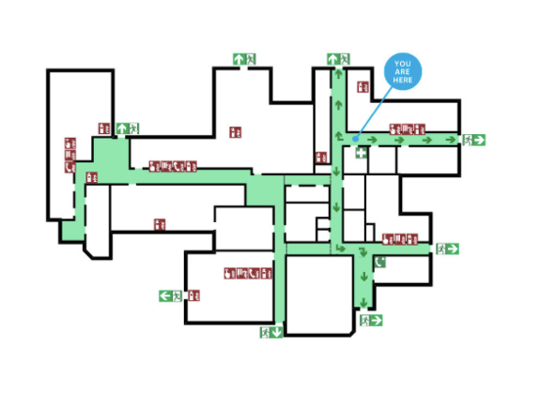
Harms / Sarl Project
122116 Chung-Rae Lee
13010979 Jihun Lim
15011023 Woo-Seok Jo

Slide 2
Intro : What is Harms / Sarl ?
Harms stands for Human, agent, robot, machine, sensor

Slide 3
Intro : What is Harms / Sarl ?
Sarl is an agent oriented language
-Built-in framework available for multi-agent modeling
-Main concepts include Agent, Capacity, Space and Skill

Slide 4
Motivation
Hillsborough Disaster
Hillsborough Stadium

Slide 5
Evacuation simulation using Sarl
-implemented using Sarl (contributing to Sarl)
-Agents calculating their directions individually
-Push/pressure concept implementation
-Graph for showing the results of pressure
Motivation
Hillsborough Disaster
Hillsborough Stadium

Slide 6
Motive : Creating a pressure based evacuation simulation
Usage for the simulation
1.Build Stadiums or buildings with proper entrance located
-location
-door amount
-door size
2.Finding the maximum amount of people allowed for a room
3.Simulate evacuation with n people and see injured amount
-calculate how many people will get injured / killed

Slide 7
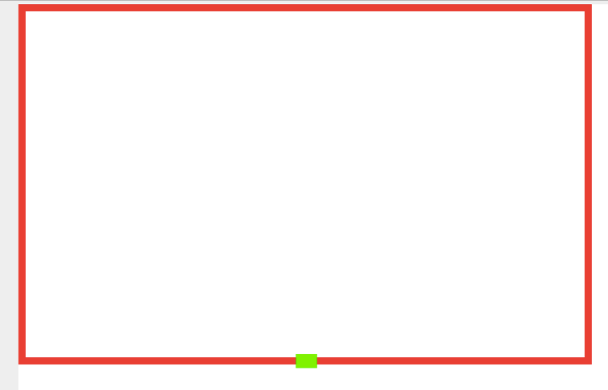
Motive : Creating a pressure based evacuation simulation
Usage for the simulation
1.Build Stadiums or buildings with proper entrance located
-location
-door amount
-door size

Slide 8
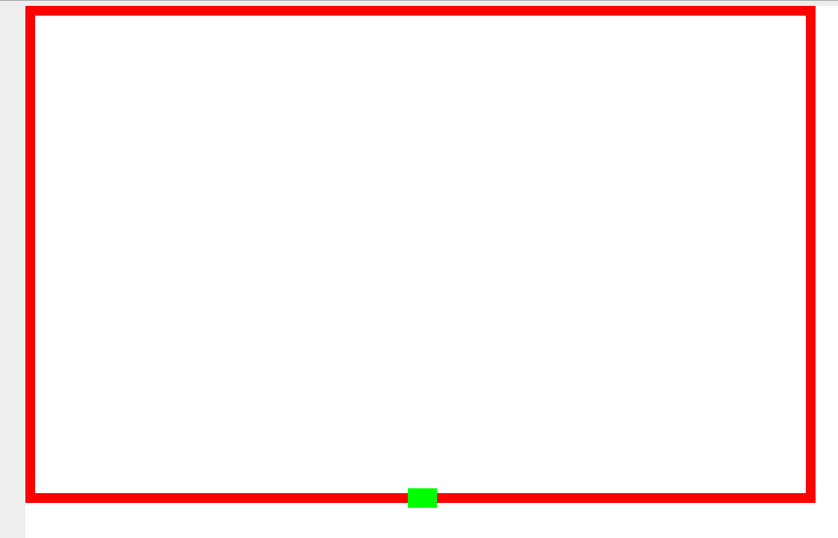

Motive : Creating a pressure based evacuation simulation
Door at the center vs Door at the corner
Which room will be more safe in evacuation scenario?

Slide 9

Motive : Creating a pressure based evacuation simulation
1 Door vs 2 Doors
Which room will be more safe by how much
in evacuation scenario?

Slide 10


Motive : Creating a pressure based evacuation simulation
Small door vs Large door
Which room will be more safe by how much
in evacuation scenario?

Slide 11
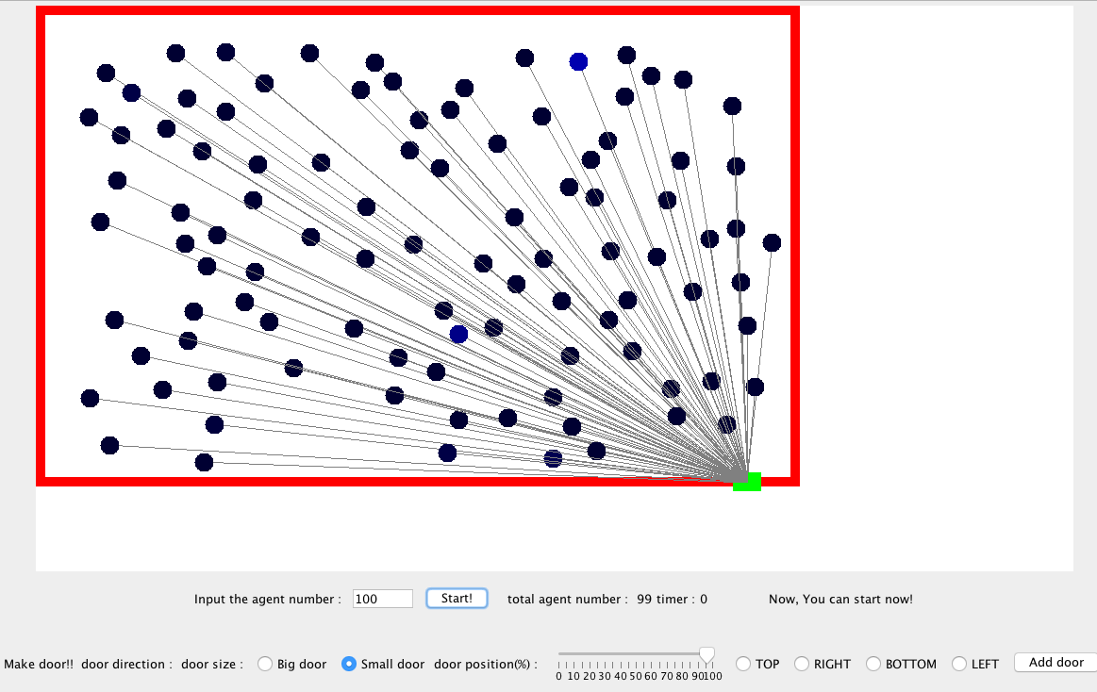
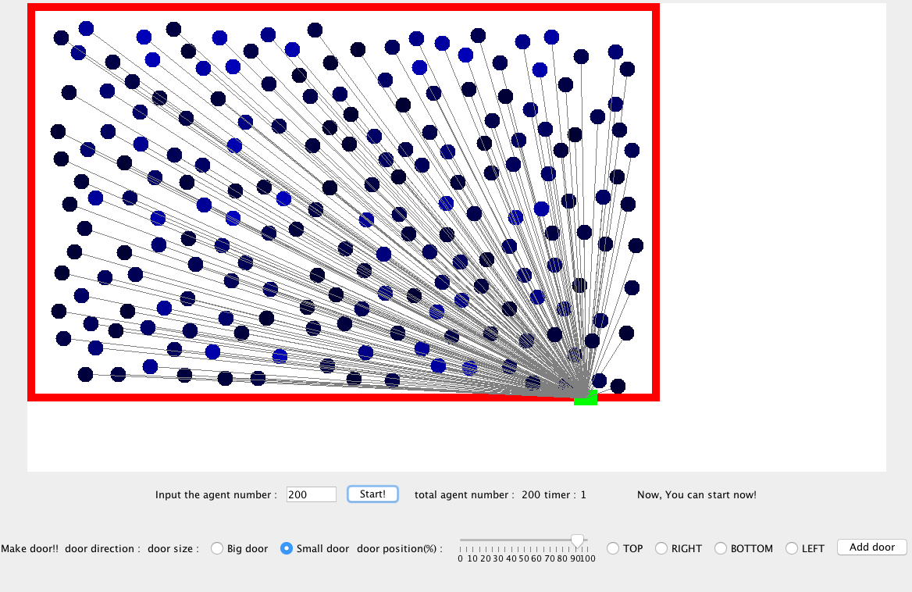
Motive : Creating a pressure based evacuation simulation
2. What is the maximum capacity allowed in the building?
How would the difference be between
100 people in a room vs 200 people in a room?

Slide 12
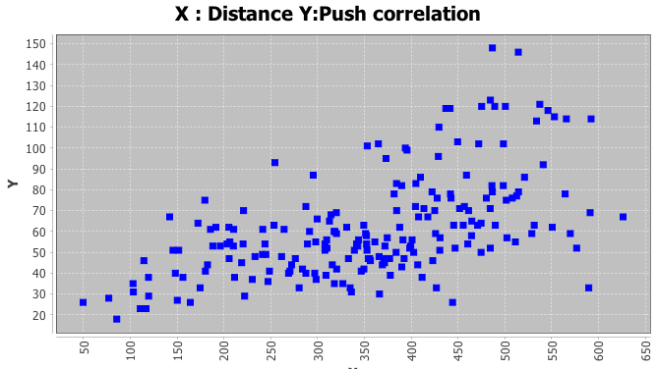
Motive : Creating a pressure based evacuation simulation
3. How many people will get injured / killed?
Estimating how many people will get hurt

Slide 13
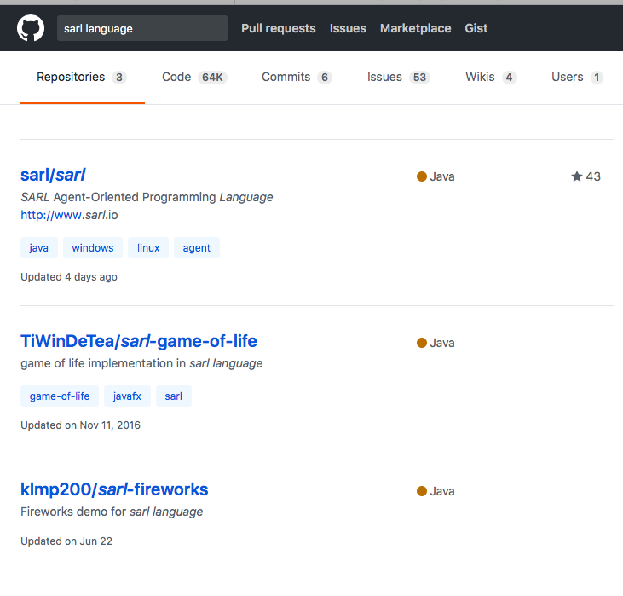
Background
Around ~5 projects using Sarl language seen so far

Slide 14

Background
Need some Human Instinct knowledge
-using the principle that humans tend to find shortest distance to
the door

Slide 15
Background
Need to know How Sarl works

Slide 16
Background
Need to know How Sarl / Java can be connected

Slide 17
Technical Details : How the program works
Execute Manager in Sarl

Slide 18
Technical Details : How the program works
Manager executes Java GUI

Slide 19
Technical Details : How the program works
Manager listens for Java GUI until
Simulation Start button executed

Slide 20
Technical Details : How the program works
Manager spawns agents corresponding to each
Circle in the java GUI and links it with agent_id.
Sarl human agents
1:1 matching

Slide 21
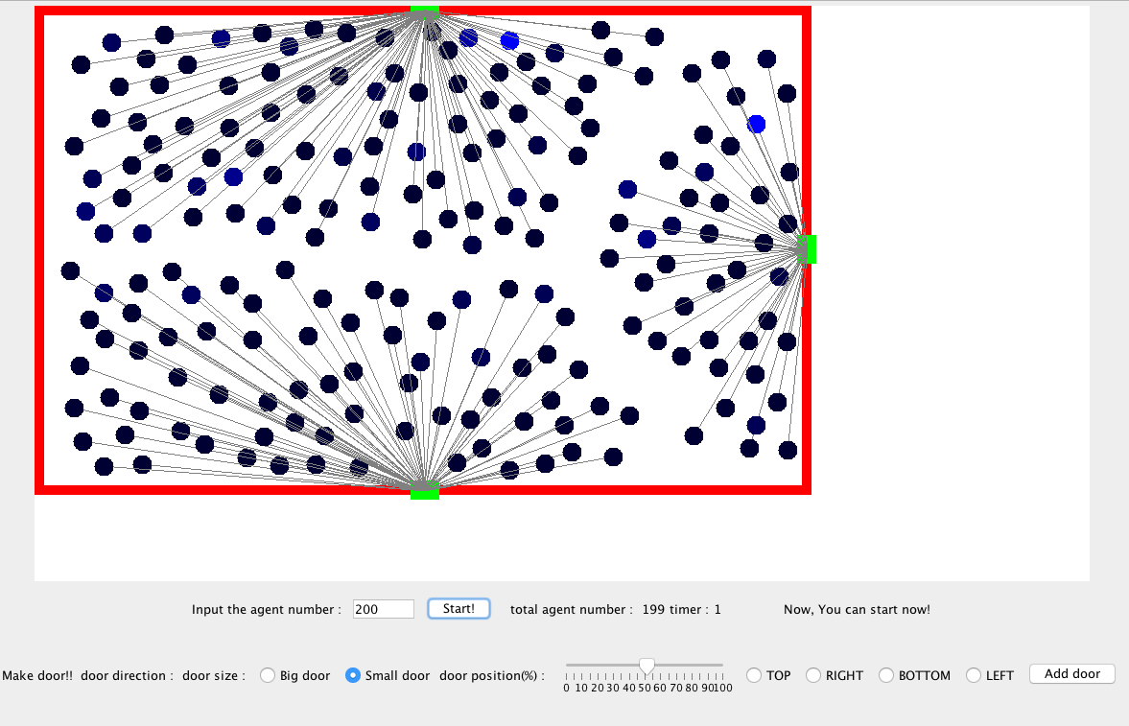
Technical Details : How the program works
Each agent will check their nearest door location
and move accordingly.

Slide 22
Technical Details : How the program works
To implement “check their nearest door location
and move accordingly”, we had to..
Calculate nearest door using door positions and the agent’s position
Find the vector
Move to that direction in unit size

Slide 23
Technical Details : How the program works
Each agents color will change according to the pushamount
(pressure amount)
Black : not pushed
Dark blue : pushed little
Blue : pushed alot

Slide 24
What Went Wrong
Collision avoidance

Slide 25
What Went Right

Slide 26
Motive : Creating a pressure based evacuation simulation
Conclusion : answering the questions
Door at the center vs Door at the corner
Which room will be more safe in evacuation scenario?

Slide 27
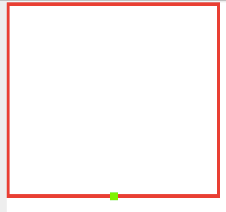
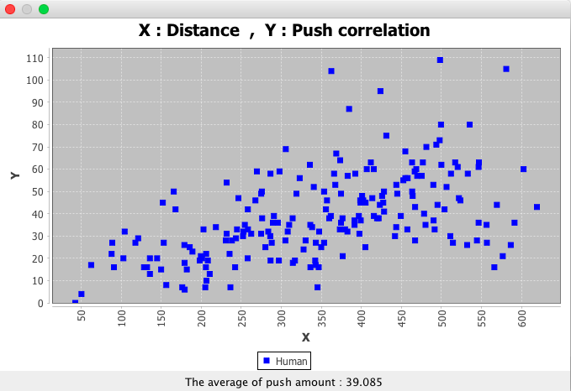
3 PEOPLE WITH MORE THAN 100 PUSHES

Slide 28

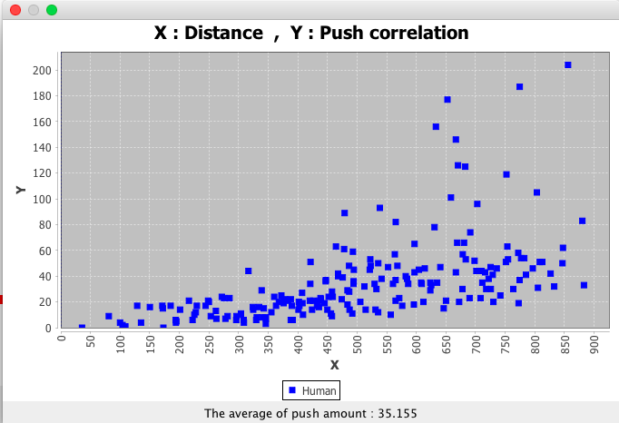
7~8 PEOPLE WITH MORE THAN 100 PUSHES

Slide 29
Motive : Creating a pressure based evacuation simulation
Conclusion : answering the questions
1 Door vs 2 Doors
Which room will be more safe by how much
in evacuation scenario?

Slide 30
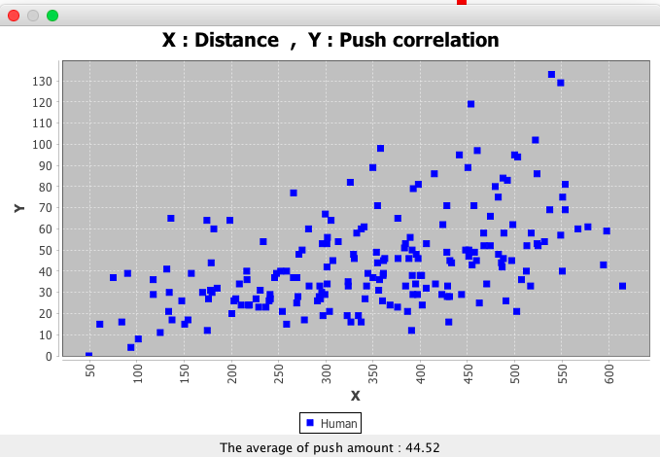


Slide 31
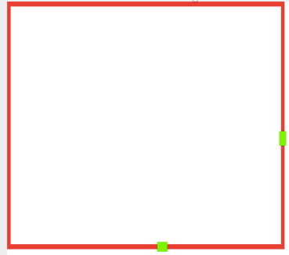
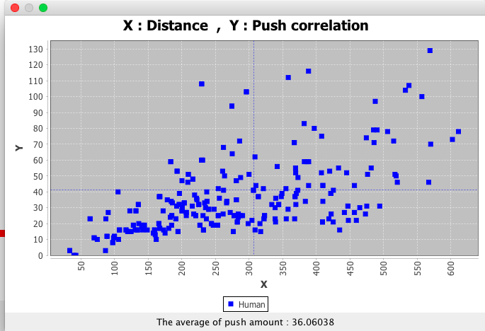

Slide 32
Motive : Creating a pressure based evacuation simulation
Conclusion : answering the questions
Small door vs Large door
Which room will be more safe by how much
in evacuation scenario?

Slide 33
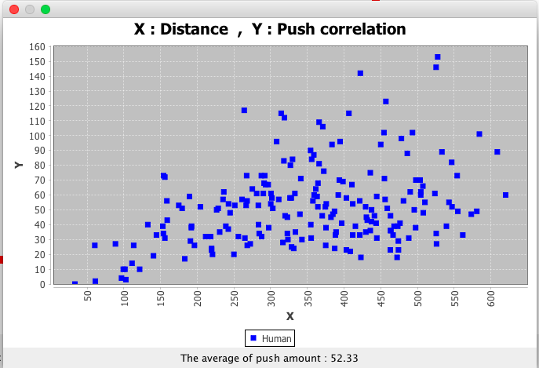
12 people over 100 pushes

Slide 34
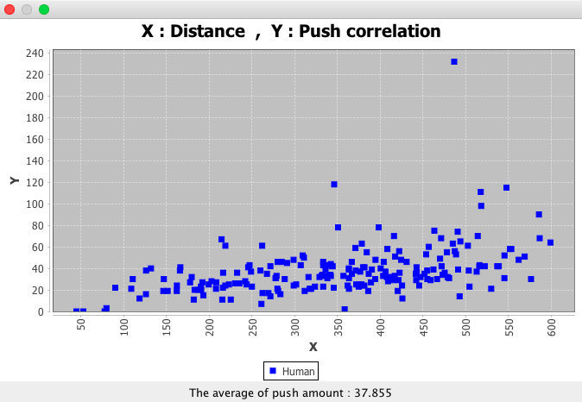
4 people over 100 pushes

Slide 35
Motive : Creating a pressure based evacuation simulation
Conclusion : answering the questions
What is the maximum capacity allowed in the building?
How would the difference be between
100 people in a room vs 200 people in a room?

Slide 36
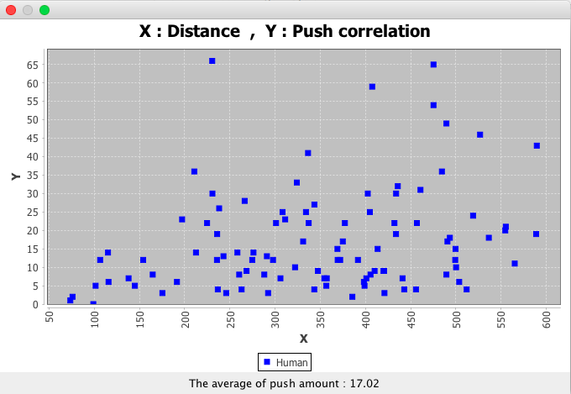

Slide 37
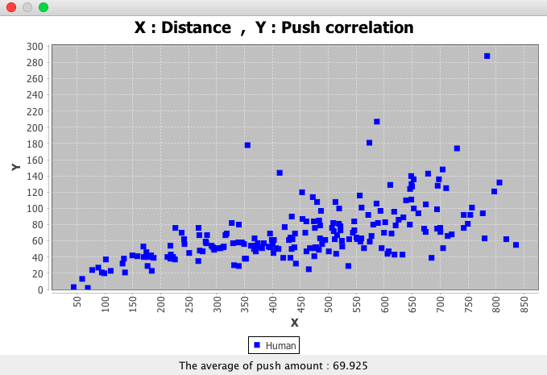

Slide 38
Motive : Creating a pressure based evacuation simulation
Conclusion
Connecting Sarl and Java was major task
Simulation results were similar to our intuitions (thankfully)
-Putting door in center vs corner : center is safer
-Putting 1 door vs 2 door : two door is slightly better
(door location matters)
-1 large door gives similar effect to 2 small doors
-100 people vs 200 people in a room : pressure/pushing
amount is not linear to the people in a room, it was 4 times
Higher (Exponentially grows)
Therefore max capacity of a building should exist for safety

Slide 39
Demo
Execution
https://www.youtube.com/watch?v=9dcFdAMivRA

